Slide 1
Fundamentals of Unix Terminal and Programming

Slide 2
What is programming?
What do we program?
How do we program?

Slide 3
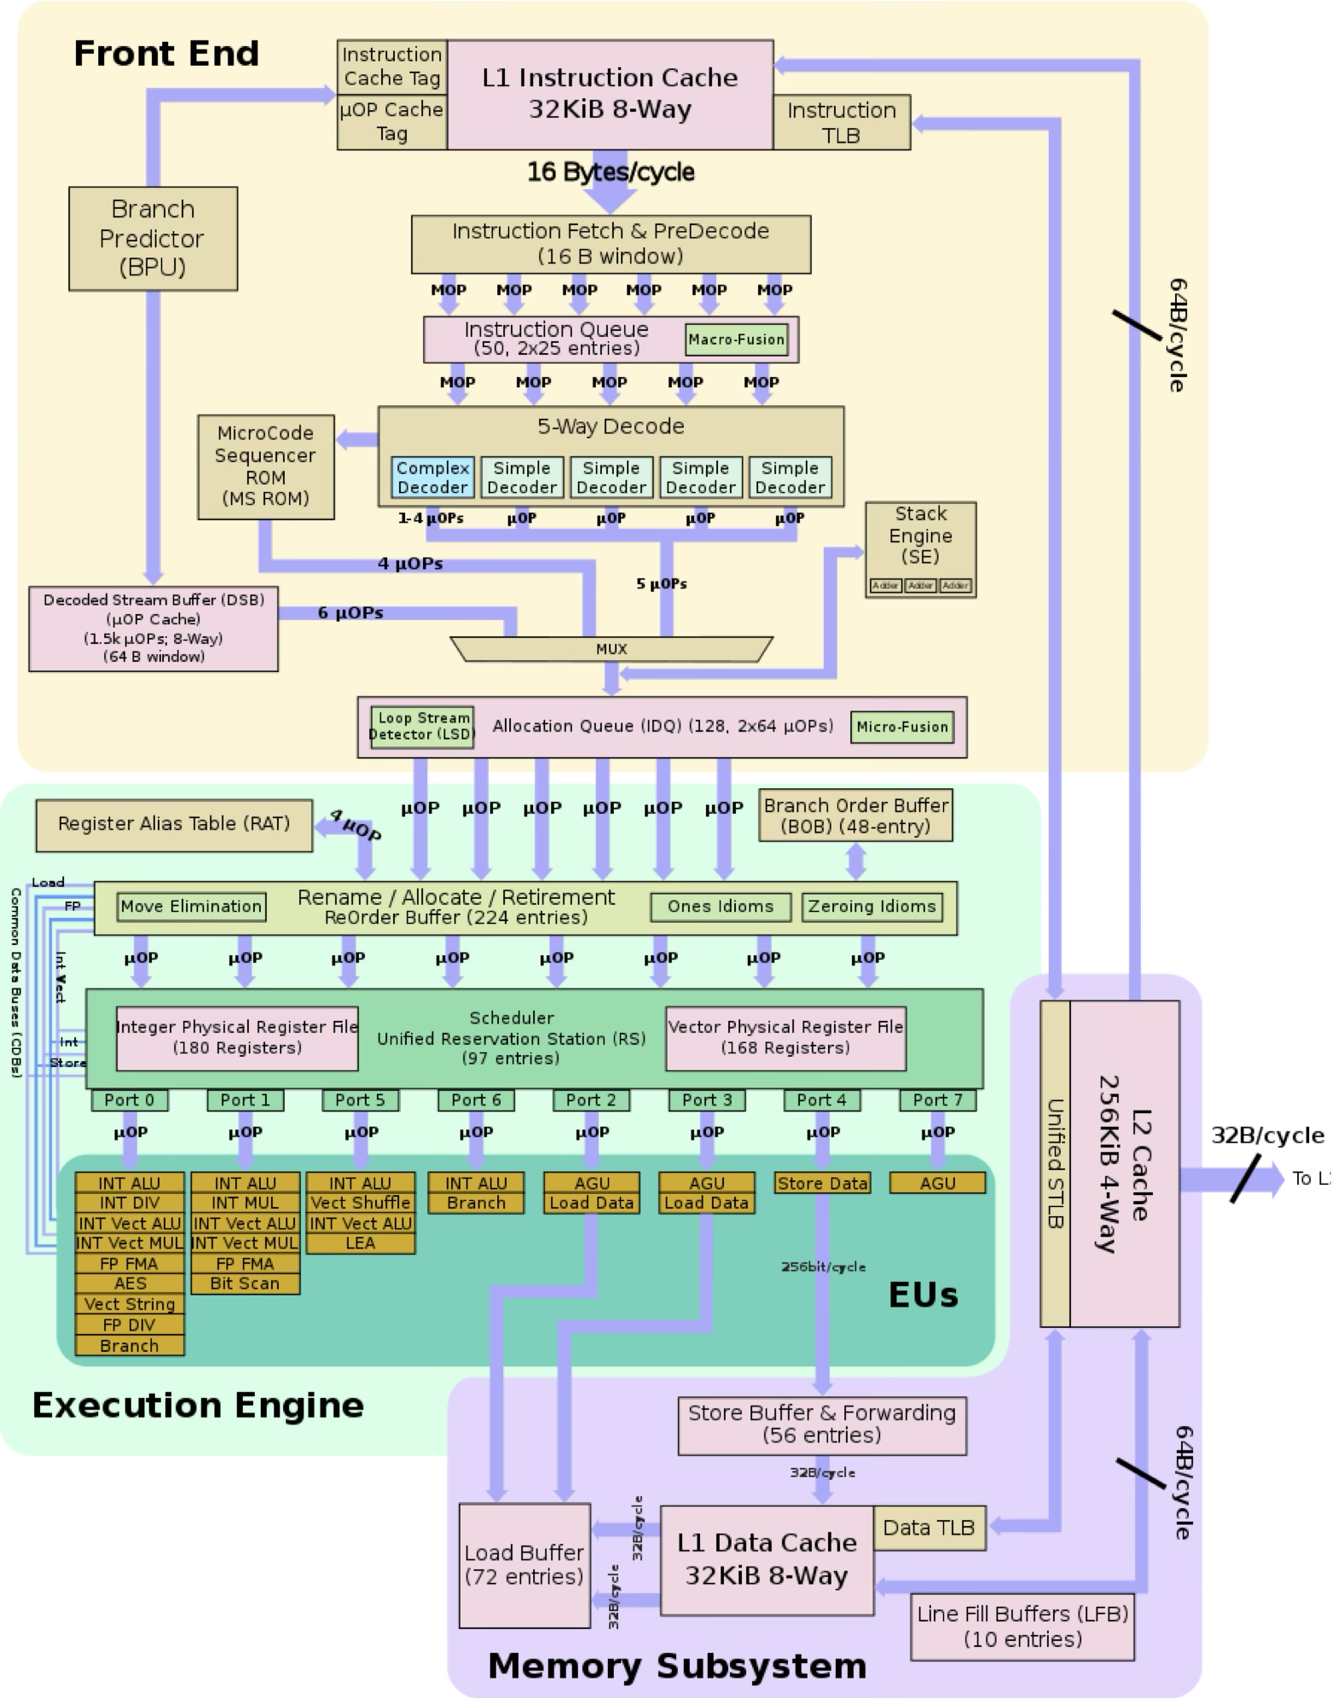
What do we program?
CPU: Central Processing Unit
Simple Instructions:
Movement of data
Arithmetic operations (+, -, /, x)
Logical Operations (AND, OR, NOT)
A few more specific things
Deterministic: completely predictable
Single-core microarchitecture design (Intel 9th Gen, 2017) - https://en.wikichip.org

Slide 4
What do we program?
User Program
Libraries
Operating System
Input
Output
CPU
Memory
Keyboard
Network
Storage
Display
Hardware

Slide 5
How do we program? Programming Languages
Definition: “A programming language is a formal language.” — Wikipedia
Syntax: rules to create syntactically correct programs (form)
Semantics: meaning

Slide 6
What is programming?
Answer: “a never ending journey” — Me
User Program
Libraries
Platform (e.g. Operating System / Hardware)
The more we know about the platform and available libraries, the simpler and efficient our code will be.

Slide 7
Shells

Slide 8
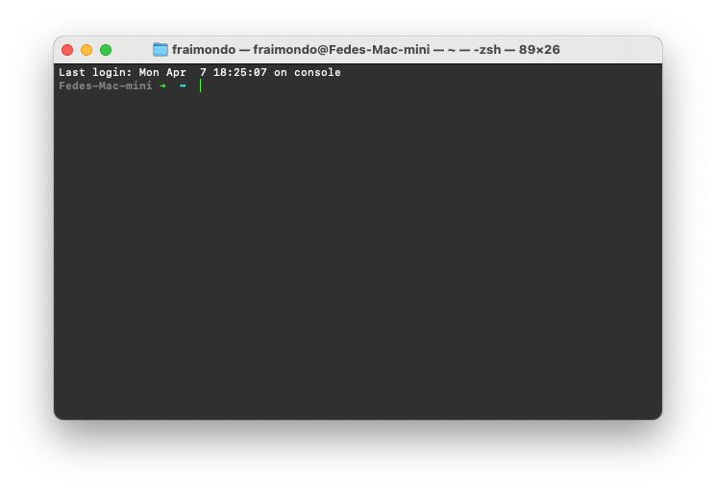
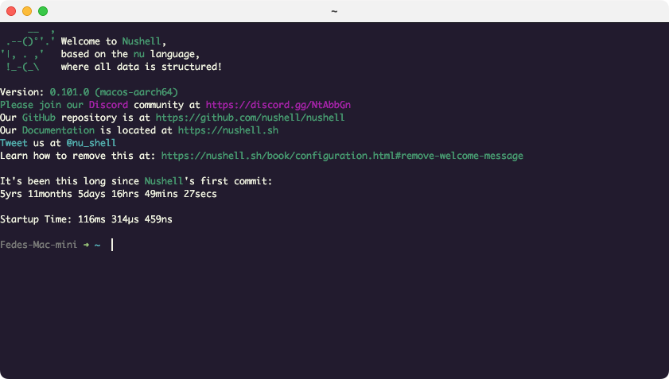
What is a shell?
Shells | Files and directories | Permissions | Script | Environmental variables | Resource | ssh | Pipes
Program to interact with the OS
Two flavours:
Graphic User Interface (GUI): e.g. windowed systems
Command Line Interface (CLI): text-based
We will focus on text-based unix-like systems (Linux, Mac):
Bourne Shell (sh)
Bourne Again Shell (bash)
Z shell (zsh)
MacOS Terminal with zsh shell
Note: In order to use a shell from a GUI, we use Terminal Emulators
Kitty Terminal with nushell

Slide 9
Files and directories: The Unix Virtual Filesystem Tree*
Shells | Files and directories | Permissions | Script | Environmental variables | Resource | ssh | Pipes
..
/ (root)
.
bin
data
dev
etc
home
usr
var
bash
zsh
archive
project
sda
zero
fraimondo
~
bin
Navigating the system
bash
zsh
cd /
cd home
cd fraimondo
cd /home/fraimondo
cd ~
mkdir mybin
cd mybin
ln –s /bin/bash .
ls –la .
<- absolute path
<- relative path
<- create a directory
<- create a symbolic link
cd ..
cd /home/././././fraimondo
cd /home/fraimondo/../../
cd ~
pwd
<- where am I?
*this is an example; many other directories and files are there

Slide 10
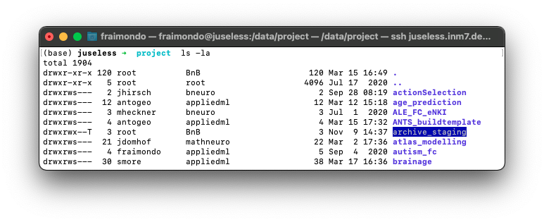
Permissions
Shells | Files and directories | Permissions | Script | Environmental variables | Resource | ssh | Pipes
File mode bits
d
r
w
x
r
-
x
r
-
x
Element type
- | file
d | directory
l | symbolic link
s | socket
p | pipe
c | character device
b | block device
Permissions
Owner
Group
Examples
Permissions
Commands
cd ~
mkdir test_shell
cd test_shell
ls -la
chgrp appliedml .
chmod +x .
chmod g+w .
chmod o+rwx .
chmod a-x .
cd ../test_shell
chmod | change file mode bits
r | read
w | write
x | execute
s | special
t | sticky
chmod [ugoa][+-][r][w][x]
user
group
other
all
chown | change file owner and group
chown user
chgrp | change file owner and group
chgrp group

Slide 11
Permissions (by default)
Shells | Files and directories | Permissions | Script | Environmental variables | Resource | ssh | Pipes
File mode bits
d
r
w
x
r
-
x
r
-
x
Permissions
r | read (4)
w | write (2)
x | execute (1)
Permissions
Owner
Group
rw | read+write (6)
rx | read+exec (5)
rwx | read+wr+ex (7)
For newly created files and dirs:
Ownership:
Default owner and group: username
But:
If sticky bit set in directory -> group
Permissions
“umask”
(what we do NOT want to give)
chmod 777 ./mybash
umask 002 -> 775
umask 022 -> 755

Slide 12
Scripts
Shells | Files and directories | Permissions | Script | Environmental variables | Resource | ssh | Pipes
Definition: “A scripting or script language is a programming language for a special run-time environment that automates the execution of tasks.” — Wikipedia
Tasks that can be done by a human, one at a time
Often interpreted
i.e. ran line by line
Usually for small programs
SH, BASH and ZSH are also scripting languages
Turing-complete languages!
Google is your friend (e.g. ”for loop bash”)

Slide 13
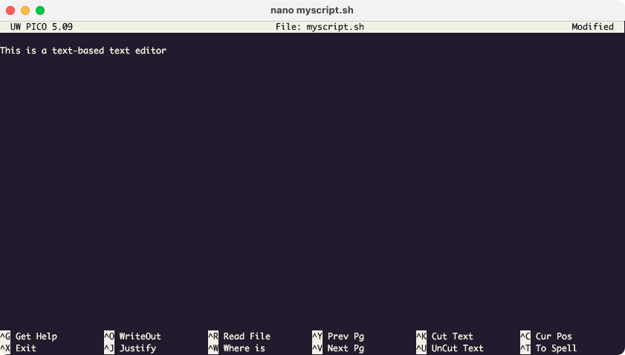
File editing (e.g. Nano)
Shells | Files and directories | Permissions | Script | Environmental variables | Resource | ssh | Pipes
nano myscript.sh
CTRL+O

Slide 14
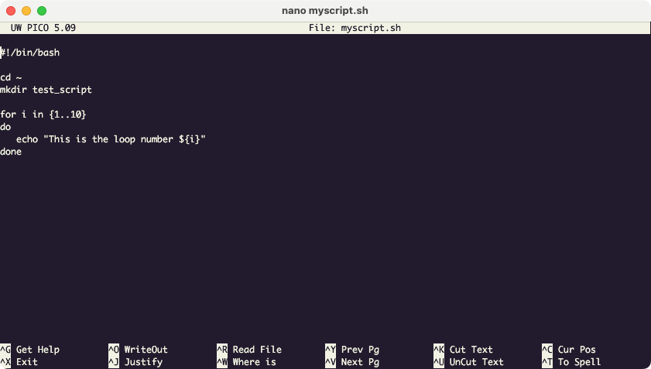
File editing (e.g. Nano)
Shells | Files and directories | Permissions | Script | Environmental variables | Resource | ssh | Pipes
nano myscript.sh
“shebang”
bash myscript.sh
./myscript.sh

Slide 15
Variables
Shells | Files and directories | Permissions | Script | Environmental variables | Resource | ssh | Pipes
Depending on where they are defined, variables have a scope
var a = 2
if a < 10 then
var b = 23
print(b)
fi
print(b) # for some languages this is an error
Examples
a=“this is a variable”
echo $a
bash
echo $a
exit
export a
echo $a
bash
echo $a
unset $a
You should see the content of a
A new bash child process is started
In the shell, variables have 3 scopes
Local: within a function
Process: within the current shell process
Environment: within the current process and its children
e.g. any program executed within the current shell
You should see a blank line (undefined)
Exit the child bash process
Commands
export | export variable (make it environmental)
env | print all environmental variables

Slide 16
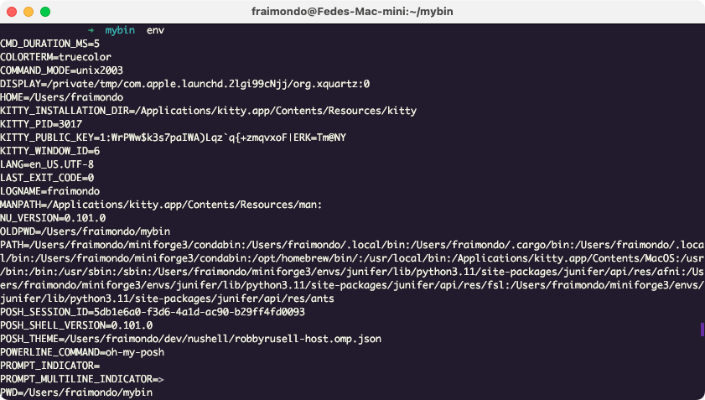
Environmental Variables
Shells | Files and directories | Permissions | Script | Environmental variables | Resource | ssh | Pipes
Usually define behaviour of underlying programs
Naming conventiong: NAME_OF_VARIABLE

Slide 17
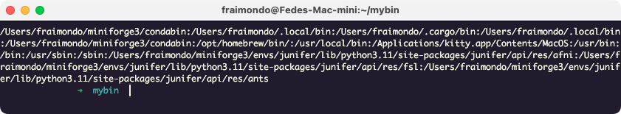
The PATH environmental variable
Shells | Files and directories | Permissions | Script | Environmental variables | Resource | ssh | Pipes
Or where to look for stuff
To execute a script we made, we need to provide the full path
E.g.: ~/course/mybin/myscript.sh
But for other programs, it is not necessary:
E.g.: bash
This is because the shell has a list of places to look for the executable files in case the full path is not specified: the PATH variable
Each element of the list is separated by “:” and the order matters
Commands
which | locate a command
echo $PATH
export PATH=“/home/fraimondo/course/mybin/:${PATH}”

Slide 18
Resource / configuration files
Shells | Files and directories | Permissions | Script | Environmental variables | Resource | ssh | Pipes
What If I need to set the path every time I start the shell?
Depending on the shell, we have specific configuration files that are taken into consideration
~/.bashrc
~/.zshrc
Etc.
Many other tools have their configuration files somewhere in the user’s home directory
SSH: ~/.ssh/config
Git: ~/.gitconfig
Conda: ~/.condarc

Slide 19
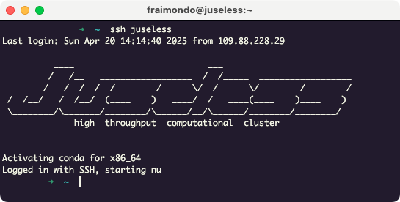
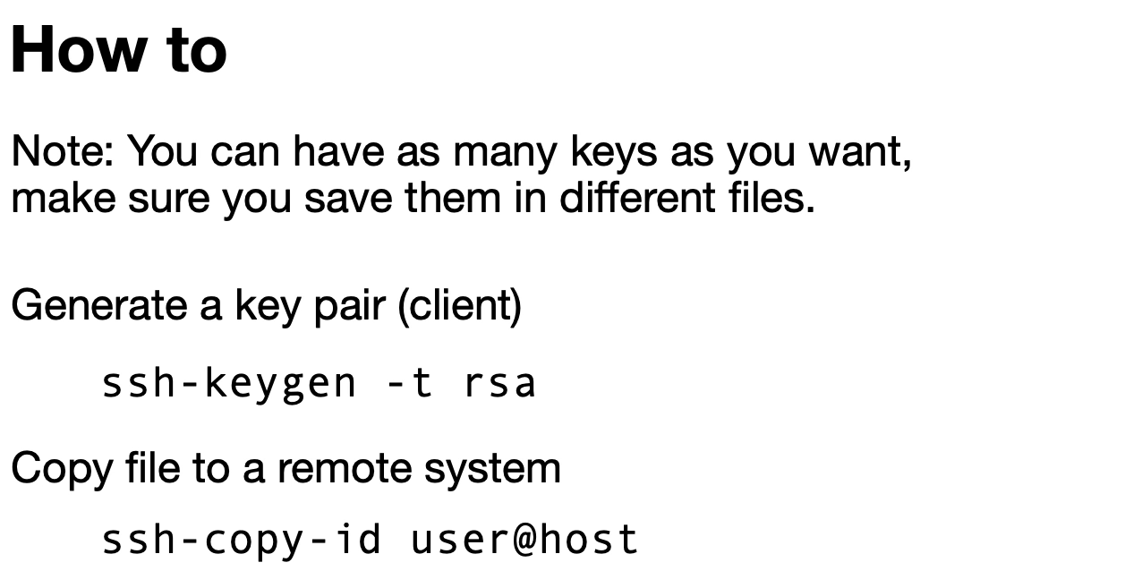
Remote Shells
Shells | Files and directories | Permissions | Script | Environmental variables | Resource | ssh | Pipes
I need to access a shell, but not here!
Secure Shell (SSH) is a network protocol to securely operate a remote shell
Basic Usage: ssh user@host
Example: ssh fraimondo@juseless.inm7.de
It’s quite simple, but can be simpler:
Host aliases can be used to define parameters
E.g in ~/.ssh/config (in the client computer)
Then just ssh juseless
Private/Public key pairs can be used to authenticate (without password!)
The private key is stored in the client
Host juseless
HostName juseless.inm7.de
User fraimondo
ServerAliveInterval 60
ServerAliveCountMax 100

Slide 20
Data Transfer
Shells | Files and directories | Permissions | Script | Environmental variables | Resource | ssh | Pipes
Commands
scp | secure copy protocol (over ssh)
rsync | sync protocol (works locally and remote)
wget | network downloader
mkdir test_copy
scp –r test_copy juseless.inm7.de:.
rsync -apvz test_copy juseless.inm7.de:.
wget https://urltosomefile.com/pathtofile.txt
This will copy
This will synchronize (only copy new)
This will copy
Just download the file from some URL

Slide 21
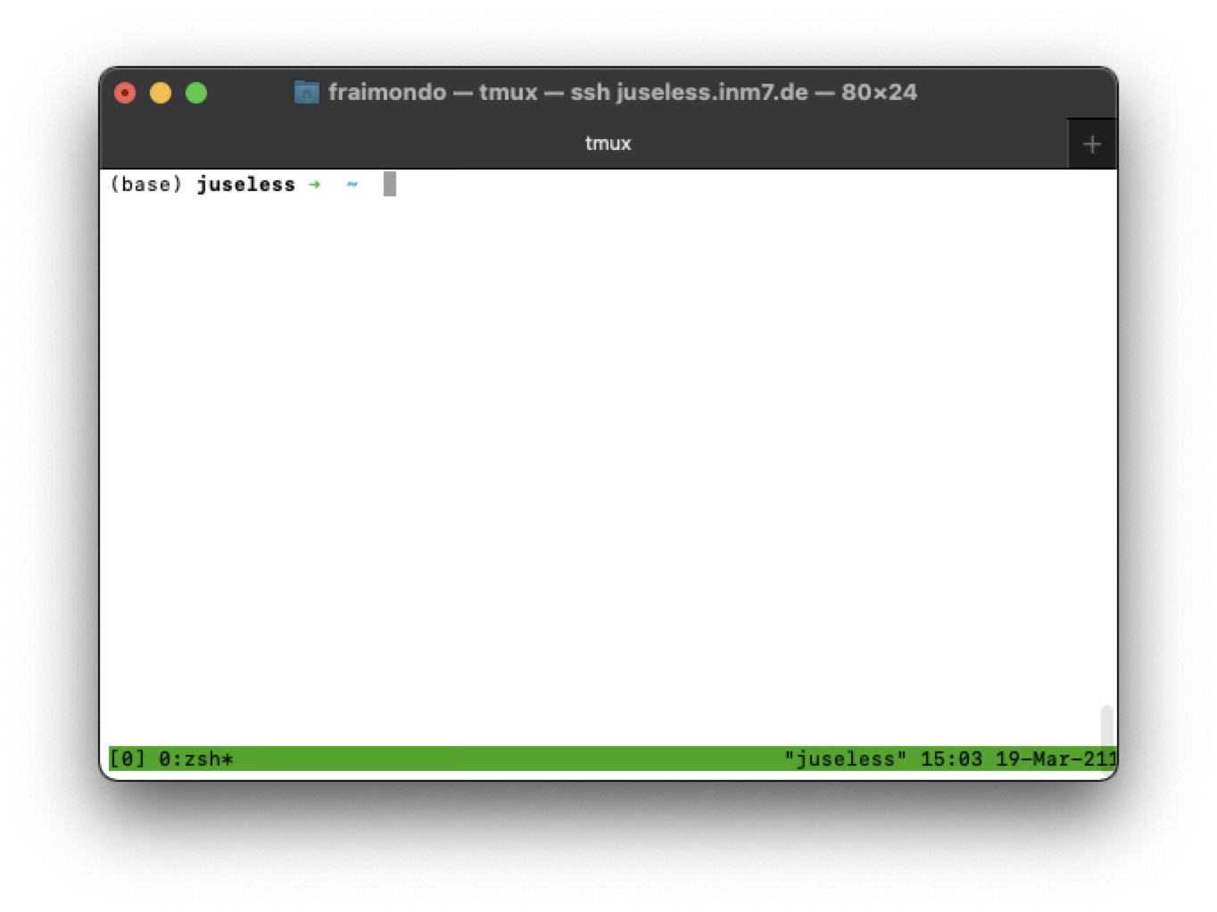
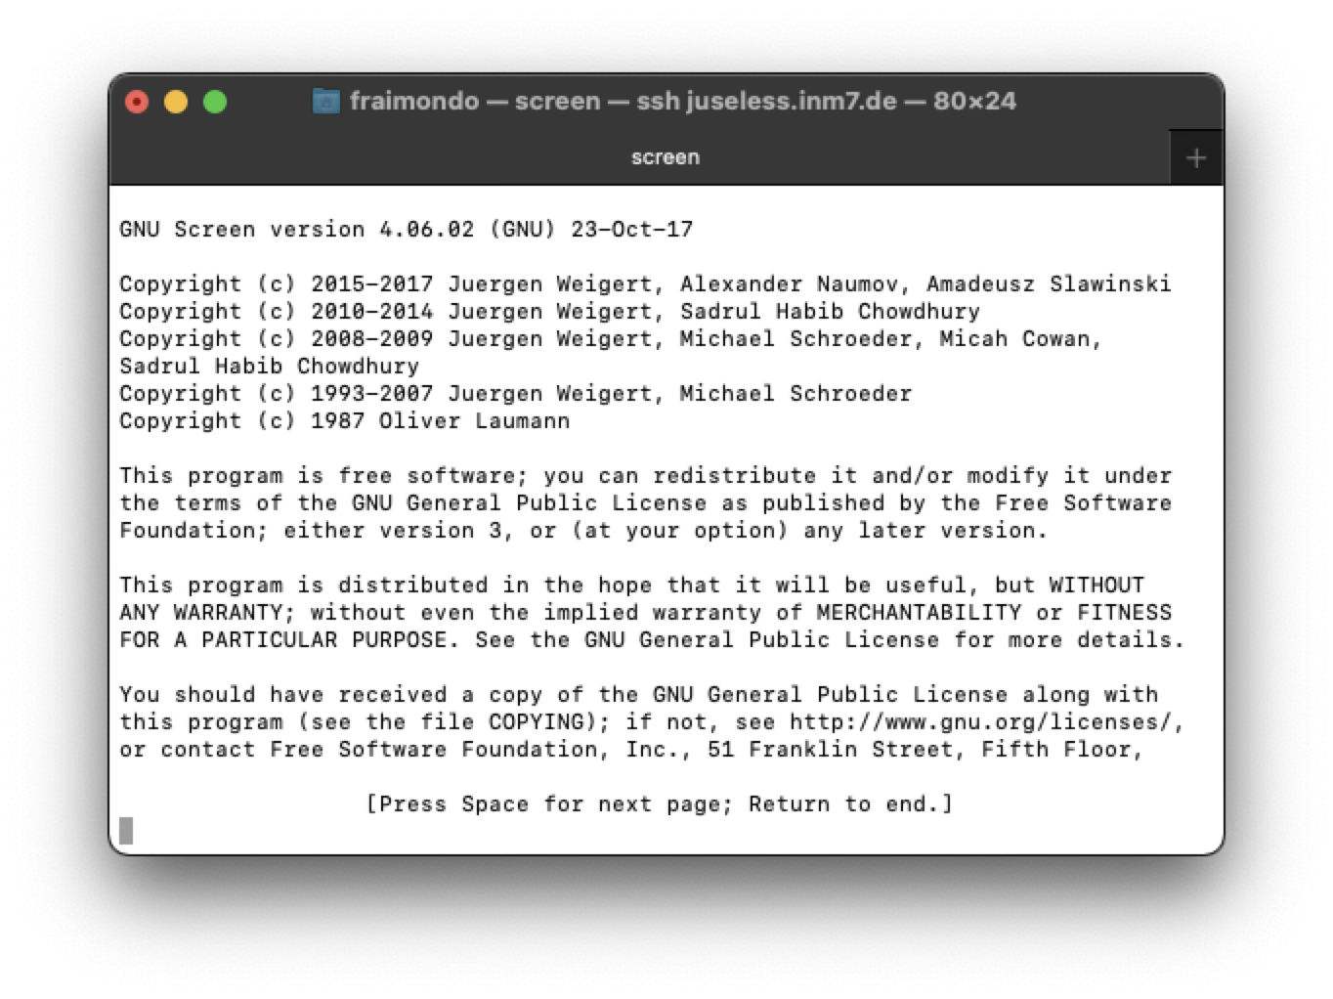
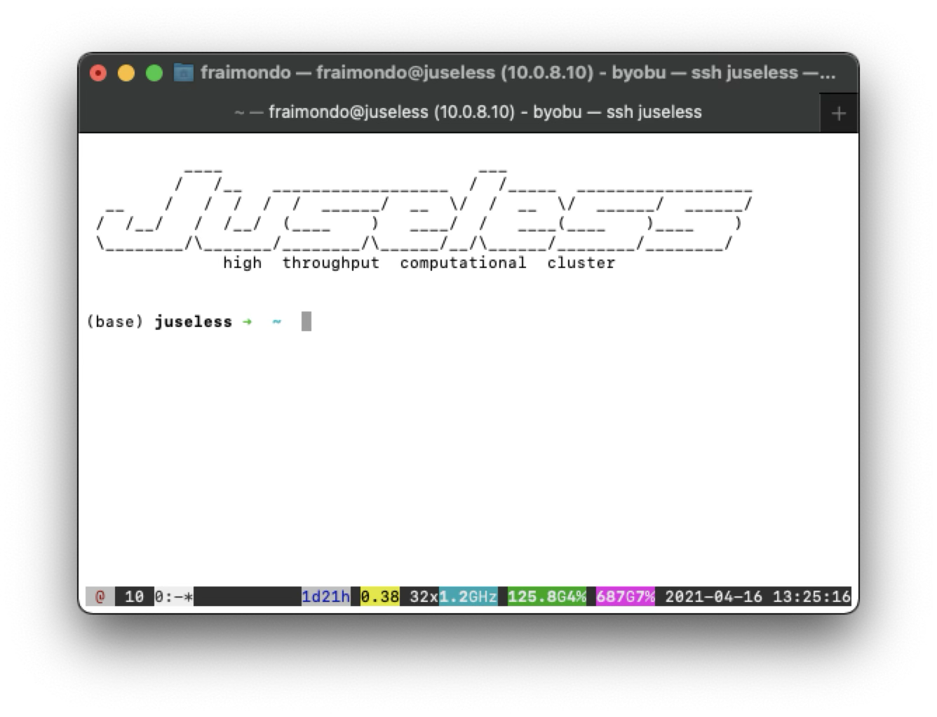
Persistent remote shell
Shells | Files and directories | Permissions | Script | Environmental variables | Resource | ssh | Pipes
A remote shell is a local process (in the client) that exists as long as the connection is open
As any process, if the parent process ends (connection broken), the child are terminated
Unless we use a terminal multiplexer
tmux
screen
byobu

Slide 22
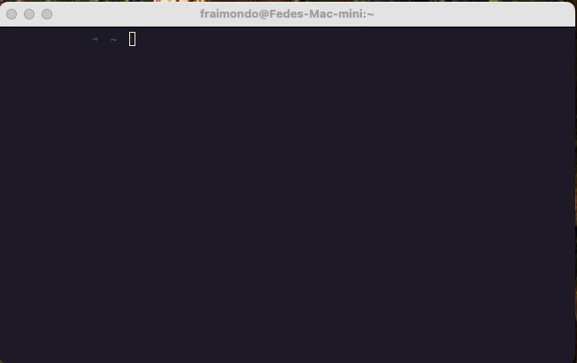
Persistent remote shell
Shells | Files and directories | Permissions | Script | Environmental variables | Resource | ssh | Pipes

Slide 23
Input/Output: special files
Shells | Files and directories | Permissions | Script | Environmental variables | Resource | ssh | Pipes
As mentioned before, there are two kinds of special files
Block devices: access with addresses. E.g. memory, drives
Character devices: access as a stream
/dev/zero
/dev/random
/dev/null
/dev/stdin
/dev/stdout
/dev/stderr
Example
(use CTRL+C) to stop
cat /dev/random

Slide 24
Input/Output
Shells | Files and directories | Permissions | Script | Environmental variables | Resource | ssh | Pipes
CLI processes read from stdin and write to stdout/stderr
Ej-1: echo Hola
Will echo the arguments into stdout
Ej-2: cat myscript.sh
Will read from the file and write to stdout
But we can redirect stdin, stdout and stderr!
Example
echo Hola > log.txt
cat - < log.txt
echo another line >> log.txt
cat - < log.txt
echo yet another line >> log.txt
echo more lines >> log.txt
cat log.txt
cat log.txt | grep yet
cat log.txt | grep yet > filtered.txt
cat filtered.txt
cat nofile.txt > log.txt
cat log.txt
cat nofile.txt &>> log.txt
cat log.txt
< | redirect input
> | redirect standard output
2> | redirect standard error
&> | redirect standard output and standard error
>> | redirect standard output (append to file)
2>> | redirect standard error (append to file)
&>> | redirect standard output and standard error (append to file)
2>&1 | redirect standard error to standard output
| | redirect standard output to input (pipe)

Slide 25
Summary
Shell
Command Line Interface (CLI)
Unix Filesystem Structure
File Permissions:
chmod
chown
umask
Symbolic Links
Special Files
Scripts
Text-based file editor (e.g. Nano)
Variables and Environmental Variables
The PATH variables
Configuration files
Secure Shell (SSH)
File/Data Transfer
Terminal Multiplexer
Input/Output
/dev/stdin
/dev/stdout
/dev/stderr
Redirection and Pipes

